Slide 1
Application Security Software Vulnerabilities and Exploits CS-4440 - Introduction to Computer Security Spring 2022 Jun Xu Slides adapted from CS-577 by Jun Xu at Stevens Institute of Technology

Slide 2
Recap
We have learned about
Communication security
Web security
Network security
Next: Application security
Today: Software vulnerabilities and exploits

Slide 3
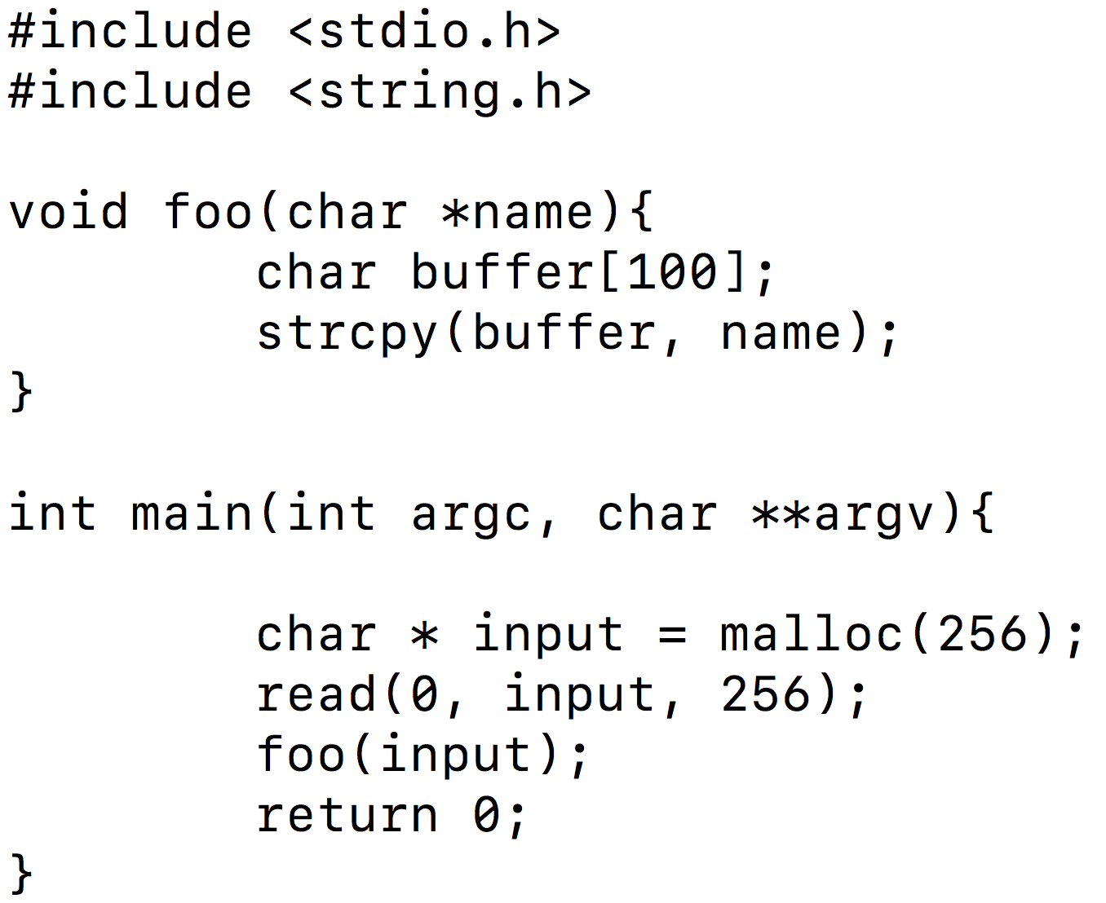
Software Vulnerabilities and Exploits: What Are They?
The First Example
int secret(){
printf(“Secret here \n”);
}
hello.c

Slide 4
The Process to Execute hello.c
Pre-processing
Assembling
hello.c
hello.i
hello.s
hello.o
hello
Compiling
Linking
Finally, you can run it:
./hello
int secret(){
printf(“Secret here \n”);
}

Slide 5
Question
When you run this program, can you execute function “secret”?
int secret(){
printf(“Secret here \n”);
}
Notes:
#include<stdio.h>
#include<string.h>
void foo(char * name){
char buffer[100];
strcpy(buffer, name);
}
int main(int argc, char **argv){
char * input = malloc(256);
read(0, input, 256);
foo(input);
return 0;
}
int secret(){
printf(“Secret here \n”);
}

Slide 6
Demo
Please see the zoom recording

Slide 7
What Happened?
“input” is copied into “buffer” without any boundary check;
However, “buffer” can keep at most 100 bytes …
Stack Overflow Could Happen!
Up to 256 bytes are read and saved into “input”
int secret(){
printf(“Secret here \n”);
}

Slide 8
Now, Let’s Run Deeper

Slide 9
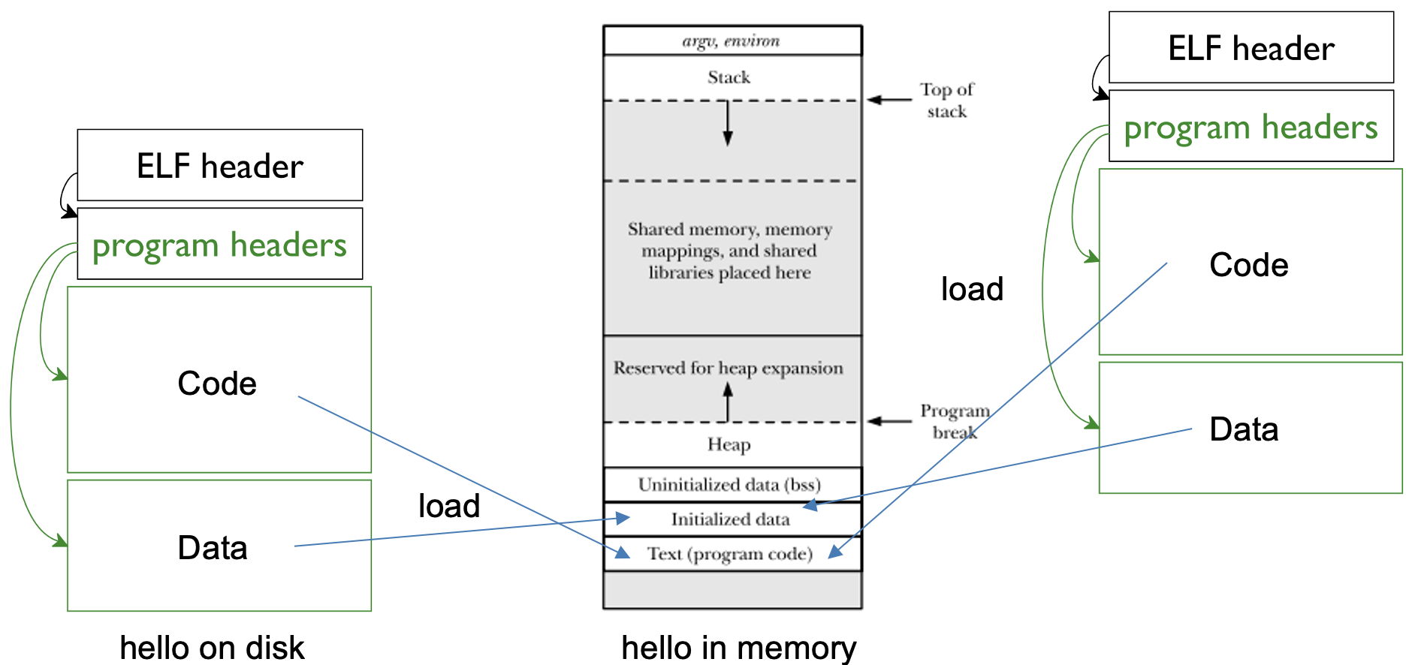
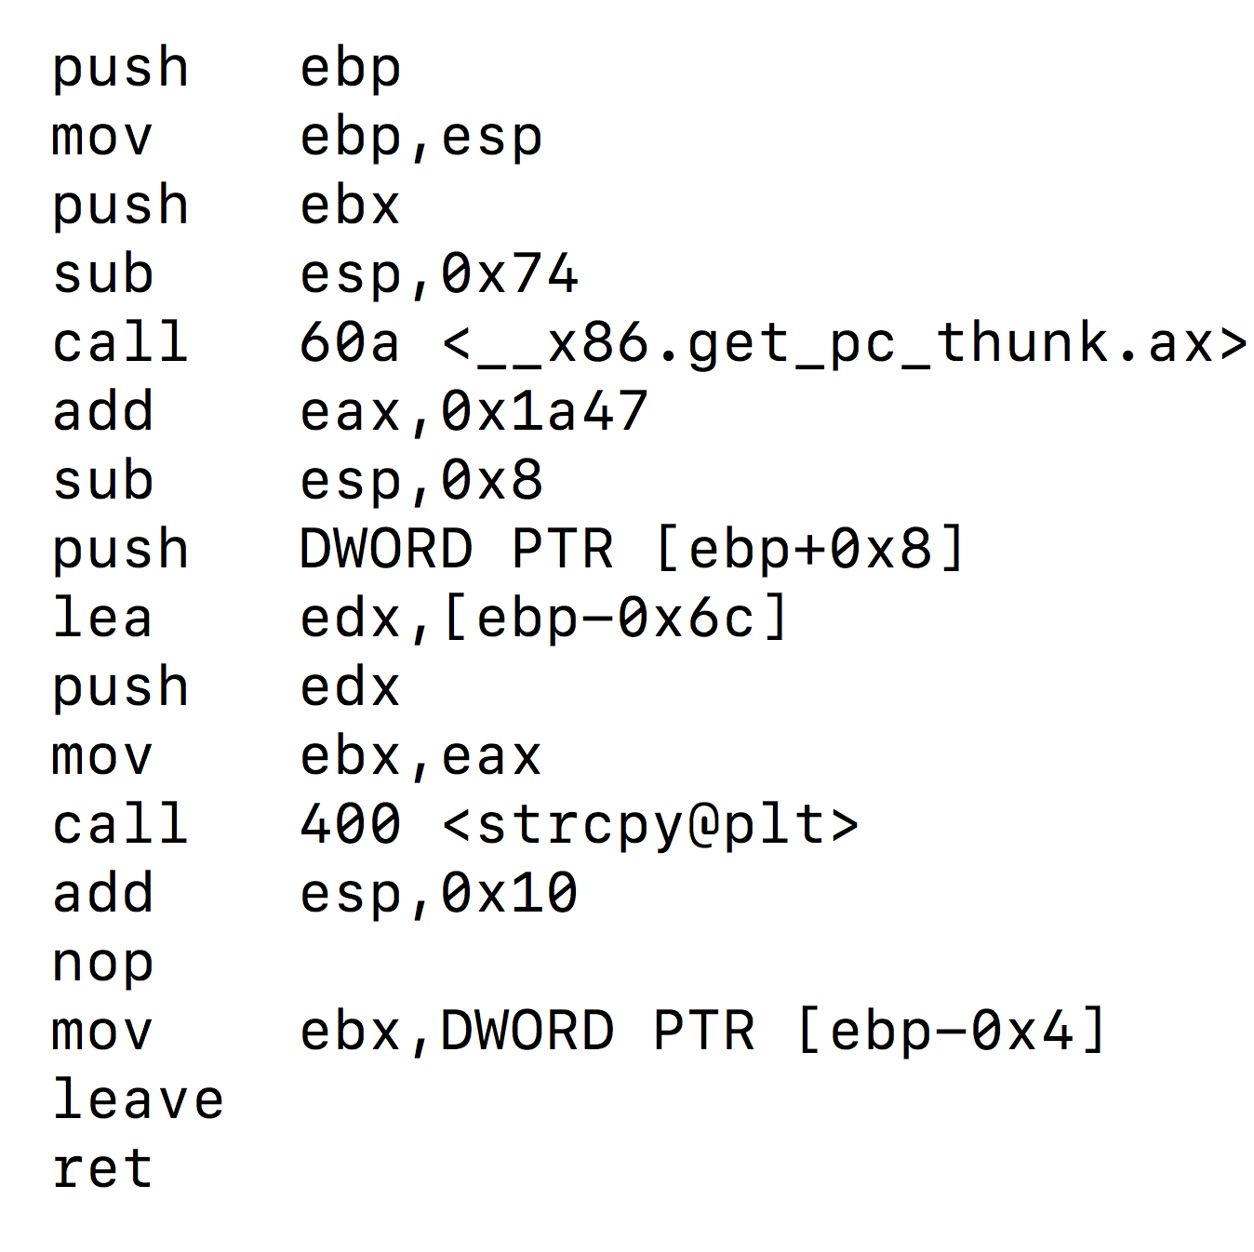
When we run hello

Slide 10
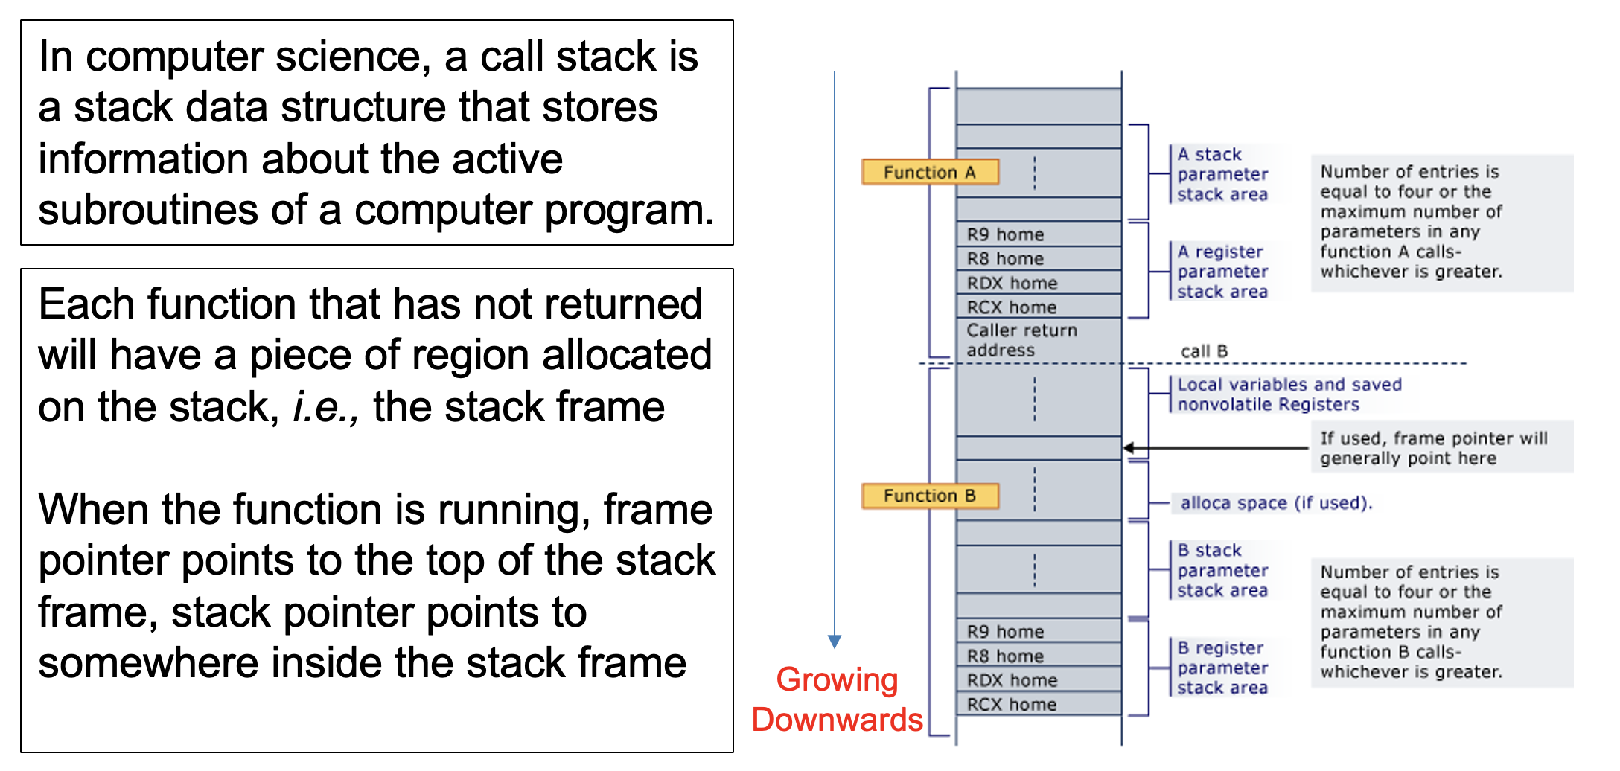
The Stack

Slide 11
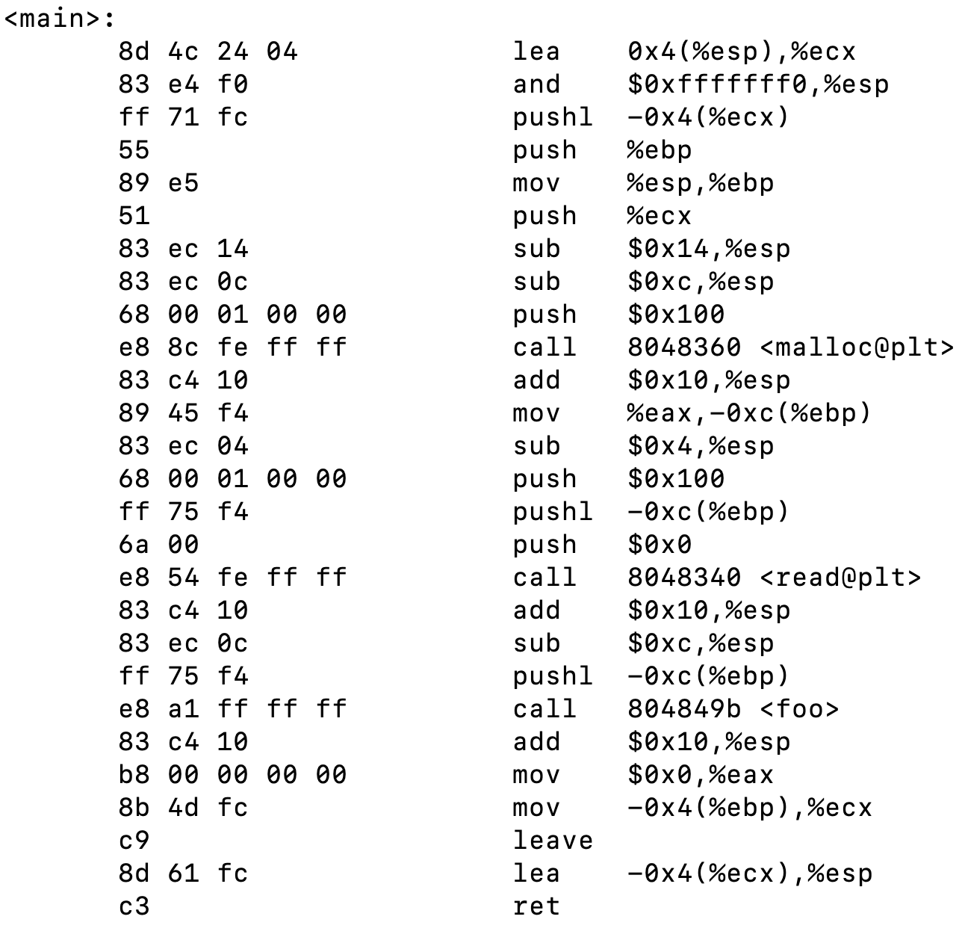
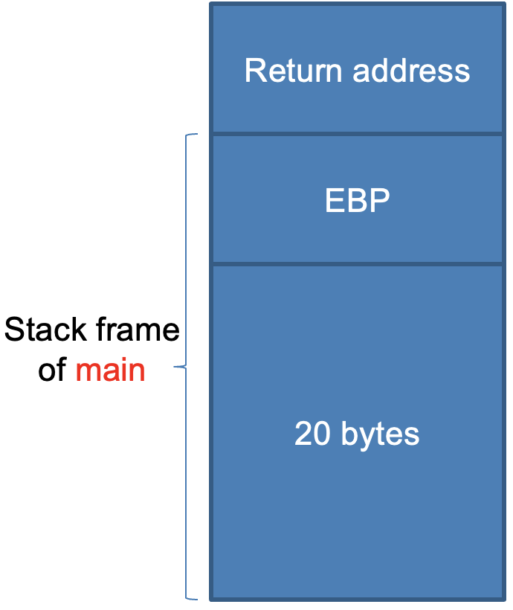
Let’s Start with Main
Call child function foo

Slide 12
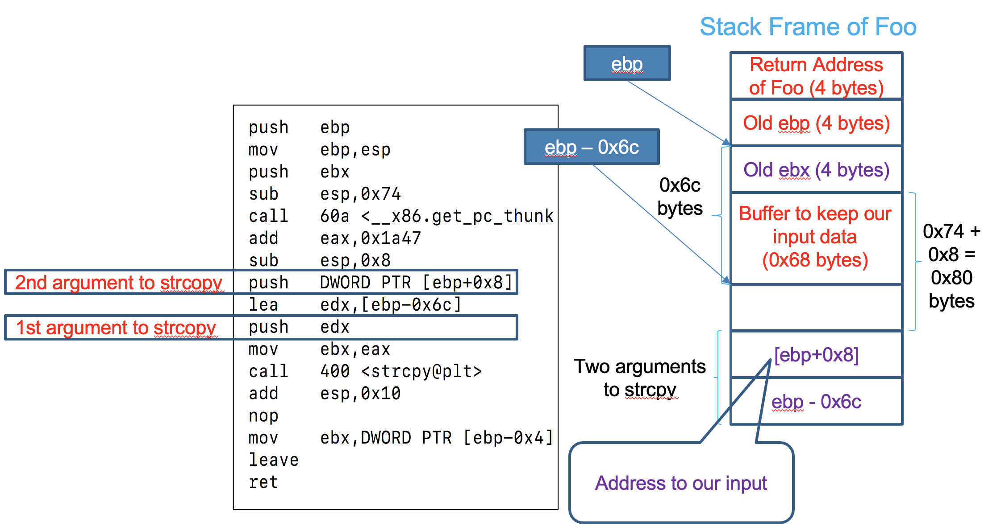
When the Execution Goes to Foo
Goes back to main

Slide 13
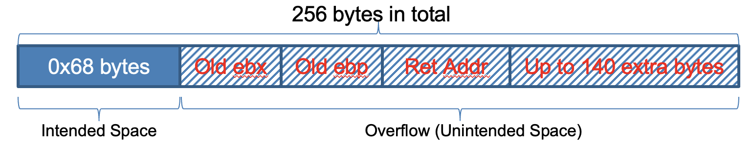
Assume We Give foo an Input of 256 Bytes

Slide 14
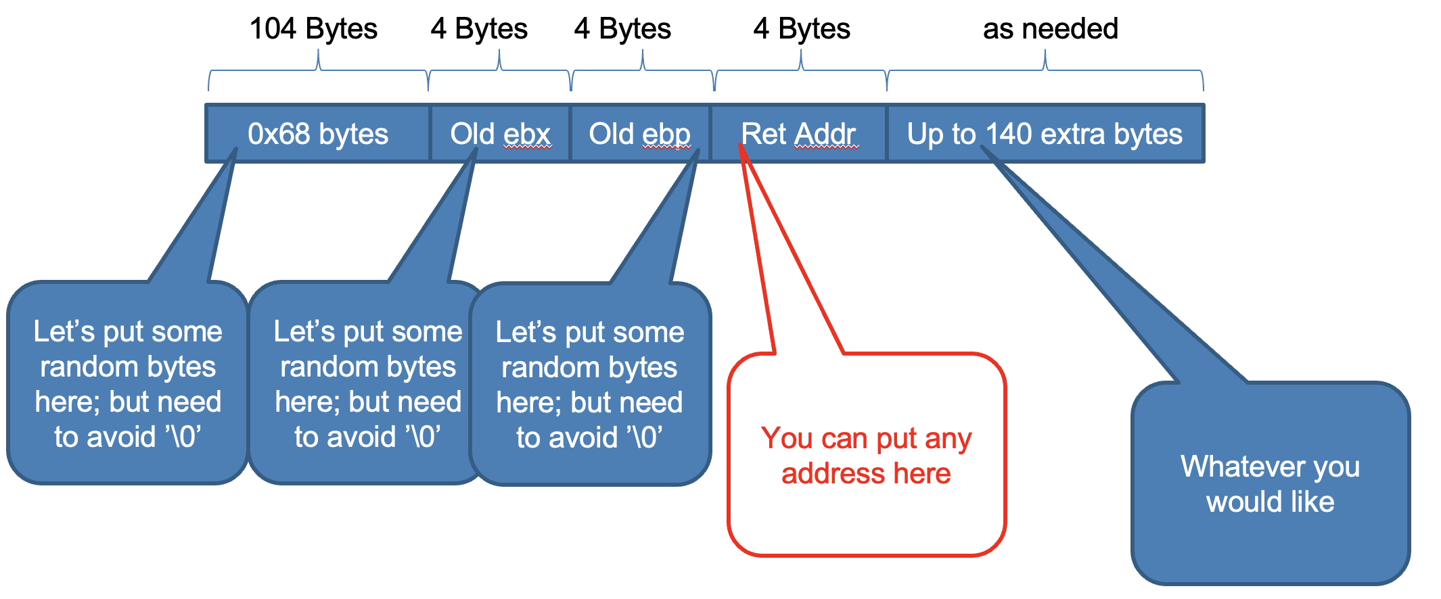
An Example

Slide 15
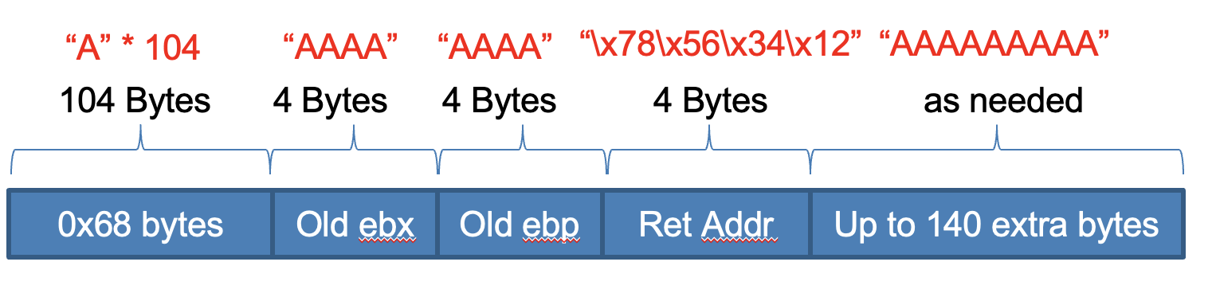
Let’s Do a Test
Demo:
Please see the zoom recording

Slide 16
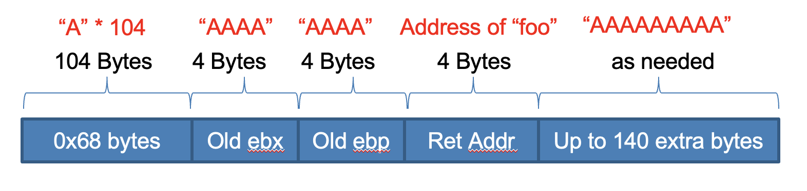
Now Let’s Do an Exploit
Demo:
Please see the zoom recording

Slide 17
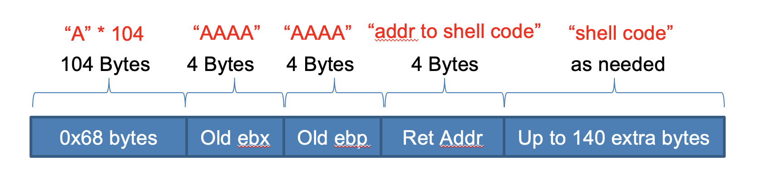
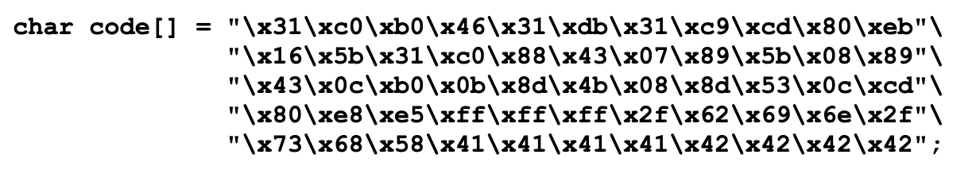
A Different Way of Exploit (Shell Code)
Shellcode to spawn a shell

Slide 18
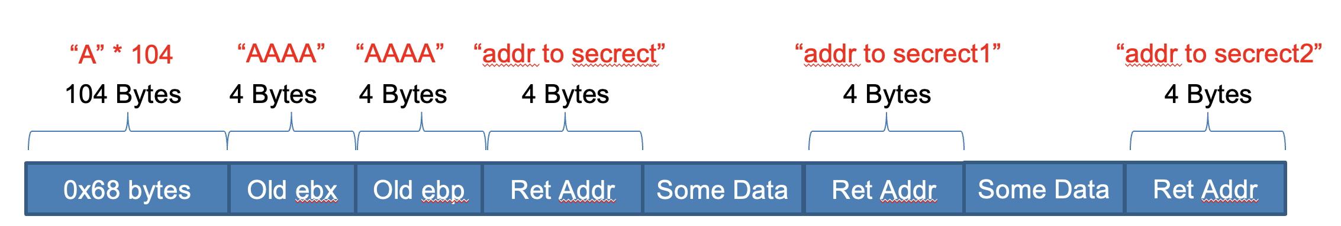
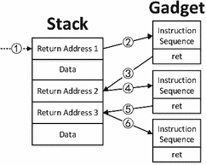
A More Advanced Exploit - Return Oriented Programming (ROP)
In this technique, an attacker gains control of the call stack to hijack program control flow and then executes carefully chosen machine instruction sequences that are already present in the machine‘s memory, called “gadgets”. Each gadget typically ends in a return instruction and is located in a subroutine within the existing program and/or shared library code. Chained together, these gadgets allow an attacker to perform arbitrary operations on a machine employing defenses that thwart simpler attacks.
-- Wikipedia (https://en.wikipedia.org/wiki/Return-oriented_programming)

Slide 19
A More General Concept: Memory Corruption
Modern programming languages like C and C++ have powerful features of explicit memory management and pointer arithmetic. These features are designed for developing efficient applications and system software. However, these features cannot ensure the memory is used in the correct way
In Python:
>>> a = [ 1, 2, 3 ]
>>> print a[10] = 0x41;
IndexError: list index out of range
In C:
int a[3] = { 1, 2, 3 };
a[10] = 0x41;
// no problem!

Slide 20
Categories Memory Corruption
Buffer overflow
Stack buffer overflow
Heap buffer overflow
Integer overflow
Signedness mixups
Integer wrap around
Format string (rarely happening today)
Uninitialized memory
Use after free

Slide 21
Categories Memory Corruption
Buffer overflow
Stack buffer overflow
Heap buffer overflow
Integer overflow
Signedness mixups
Integer wrap around
Format string (rarely happening today)
Uninitialized memory
Use after free

Slide 22
Consequences of Memory Corruption
In the presence of memory corruption vulnerabilities, what can we corrupt?
Memory that doesn't influence anything. (Boring)
Memory that is used in a value to influence mathematical operations, conditional jumps, etc (such as the win variable).
Memory that is used as a read pointer (or offset), allowing us to force the program to access arbitrary memory.
Memory that is used as a write pointer (or offset), allowing us to force the program to overwrite arbitrary memory.
Memory that is used as a code pointer (or offset), allowing us to redirect program execution!
Typically, you use one or more vulnerabilities to achieve
multiple of these effects.

Slide 23
Memory Corruption: Classic Stack Buffer Overflow
Because C does not implicitly track buffer sizes, simple overwrites are common.
Smallest possible example:
int main(int argc, char **argv, char **envp)
{
char small_buffer[16];
read(0, small_buffer, 128);
}
int win(void){
printf(“You Win!\n”);
exit(0);
}

Slide 24
Memory Corruption: Heap Buffer Overflow
Buffer overflow can happen with heap buffers as well
Smallest possible example:
int main(int argc, char **argv, char **envp)
{
char *small_buffer;
small_buffer = (char *)malloc(16);
read(0, small_buffer, 128);
}

Slide 25
Memory Corruption: Off-by-one Errors
Consider:
char a[3] = {0, 0, 0};
for (int i = 0; i <= 3; i++) a[i] = getchar();
printf(“%s”, a);
Off-by-one errors can cause small amounts of memory corruption.
Depending on what you corrupt in memory, this can be disastrous.

Slide 26
Memory Corruption: Integer Overflows
When developers try to calculate sizes, mistakes can occur...
Consider:
What's the maximum value that a 32-bit integer can take?
What happens when you increment that?
int main() {
unsigned int size;
scanf("%i", &size);
char *buf = alloca(size+1);
int n = read(0, buf, size);
buf[n] = '\0';
}

Slide 27
Memory Corruption: Signedness Mixups
The standard C library uses unsigned integers for sizes (i.e., the last argument to read, memcmp, strncpy, and others). The default integer types (short, int, long) are signed.
int main() {
int size;
char buf[16];
scanf("%i", &size);
if (size > 16) exit(1);
read(0, buf, size);
}
Why is this a problem? Recall twos compliment:
0xffffffff == -1, 0xfffffffe == -2, etc
signedness mostly matters during conditional jumps
cmp eax, 16; jae too_big
unsigned comparison
eax = 0xffffffff will result in checking 0xffffffff > 16 and a jump
cmp eax, 16; jge too_big
signed comparison
eax = 0xffffffff will result in checking -1 > 16, and no jump
Guess which one is used in this code?

Slide 28
Memory Corruption: Uninitialized Memory
Memory objects can be used before they are initialized
int main() {
void (*fun_ptr)(int);
// some other code, which does not initialize func_ptr
func_ptr(1);
}
Why is this a problem?

Slide 29
Memory Corruption: Use After Free
Memory objects can be unintentionally used after they are deallocated
struct obj{
int a;
int b;
void (*fun_ptr)(int);
}
int main() {
struct obj * instance = (struct obj *) malloc(sizeof(struct obj)) ;
//some more code here;
free(instance);
//some more code here
instance->func_ptr(1);
}
Why is this a problem?

